Slide 1

Graph Optimizations
Making Searches Faster

Slide 2
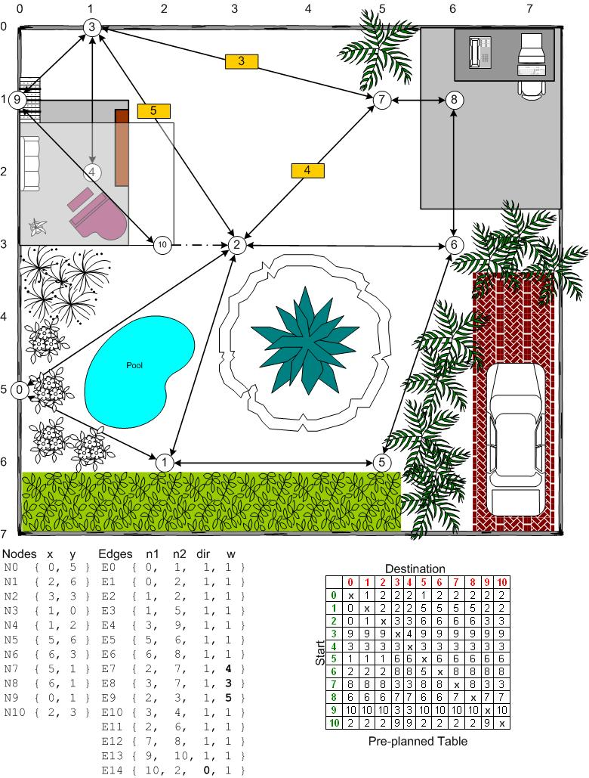
Graph Optimizations: Preplanning

Slide 3
Graph Optimizations: Preplanning
Preplanning Benefits:
Very, Very Fast (at search time)
Memory friendly (at search time)
Preplanning Drawbacks:
Not dynamic
More nodes = more memory (exponential)
Memory Use Mitigation Techniques:
Smaller data types
Relative indexing

Slide 4
Graph Optimizations: Hierarchical Path Planning
Divide and Conquer:
Break problem into parts
Solve the parts
Assemble solution
Hierarchical Path Planning (HPP) is one such technique.

Slide 5
Hierarchical Path Planning Preplanning Steps
Step 1: Generate the Low-Level Graph (All Vertices)
Step 2: Generate the High-Level Graph (Some Vertices)
Step 3: Build an Association Table to Connect the Graphs

Slide 6
Hierarchical Path Planning: Path Search
Step 1:
Plan a path through the high-level graph nodes.

Slide 7
Hierarchical Path Planning: Path Search
Step 2:
Plan paths between adjacent pairs of high-level path nodes.

Slide 8
Hierarchical Path Planning: Path Search
Step 3:
Assemble final path from each path segment.

Slide 9
Graph Optimizations: Hierarchical Path Planning
HPP Benefits:
Faster
Less memory*
HPP Drawbacks:
Difficult with dynamic map
Gives suboptimal (but usually good) paths

Slide 10

Fin

